Slide 1

DATA SCIENCE PROJECT
Road Traffic Accident Prediction
Presented By: Chaitri Bhatia
Dr.D.Y.Patil College of Engineering and Innovation,Pune,410507

Slide 2
OUTLINE
Problem Statement
Proposed System/Solution
System Development Approach
Result
Conclusion
Future Scope
References

Slide 3
Problem Statement
High incidence of road accidents resulting in fatalities and injuries.
Difficulty in predicting and preventing accidents due to a lack of accurate data and analysis.

Slide 4
Proposed Solution
1.Develop a Predictive Model : Utilize machine learning algorithms to create a model that can accurately predict road accidents based on historical data.
2.Real-time Data Integration : Integrate real-time data sources such as traffic sensors, weather updates, and GPS data to enhance the accuracy of prediction
3User-friendly Dashboard : Create an intuitive and interactive dashboard that visualizes accident predictions and risk factors.
4.Alert and Notification System : Develop an alert system to notify authorities and drivers about high-risk areas and times.
5.Policy and Infrastructure Recommendations : Generate reports with recommendations for traffic management authorities to improve road safety.

Slide 5
System Approach
Technology Used: IBM Watson Studio for data preparation, model training , and deployment IBM Watson Machine Learning to build ,train , and deploy machine learning models for accident prediction . IBM Watson Assistant for creating an interactive and user-friendly dashboard that helps users query and explore accident prediction data . IBM cloud for hosting the entire solution , ensuring scalability, security, and accessibility .
System Requirements: Compatible with modern web browsers and mobile devices.

Slide 6
Result
Utilized IBM Watson Studio for Data Analysis: Leveraged IBM Watson Studio for data preparation, feature engineering, and exploratory data analysis.
Implemented Predictive Models with IBM Watson Machine Learning: Built and trained machine learning models using IBM Watson Machine Learning to predict potential accident hotspots.
Designed an Interactive Dashboard with IBM Watson Assistant: Developed a user-friendly and interactive dashboard integrated with IBM Watson Assistant for natural language processing.
Provided Real-Time and Actionable Insights: The system provides real-time predictions and actionable insights to traffic management authorities.
Ensured Security and Confidentiality: Implemented robust security measures to protect sensitive data and ensure user privacy throughout the analysis and prediction process.

Slide 7
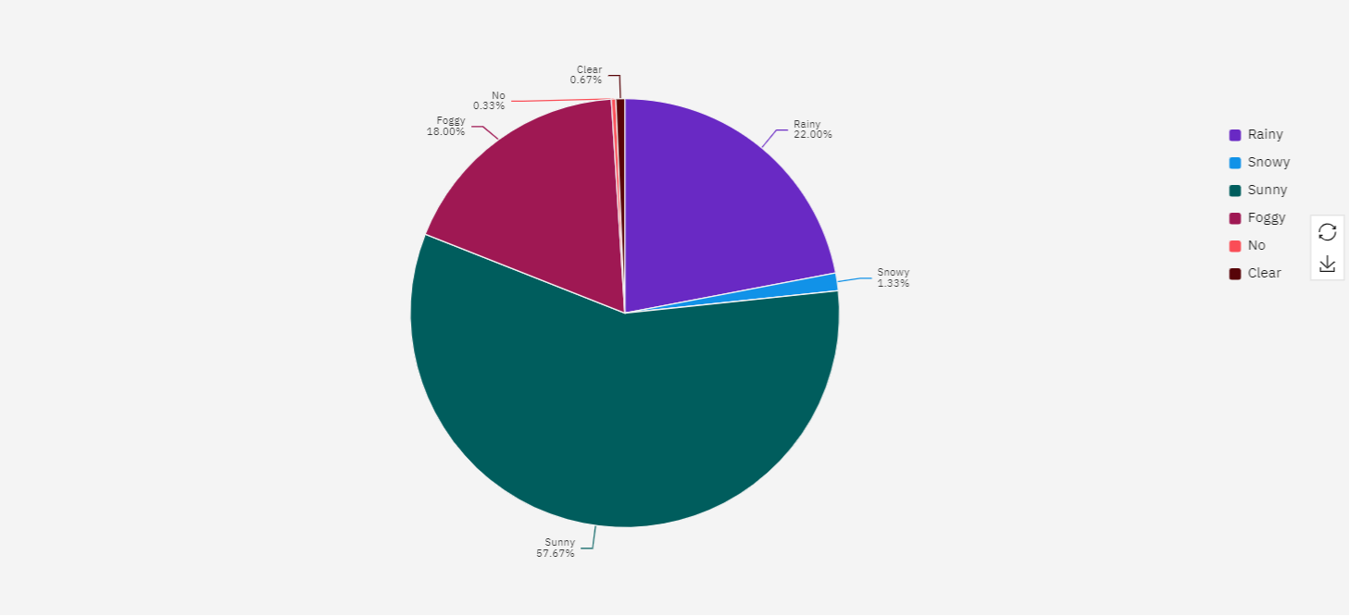
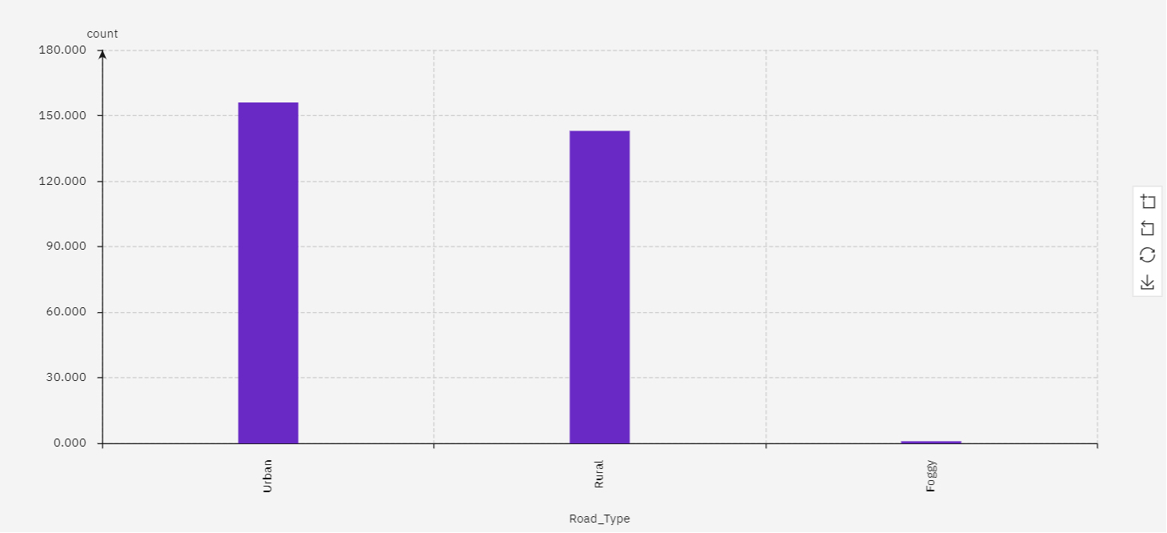
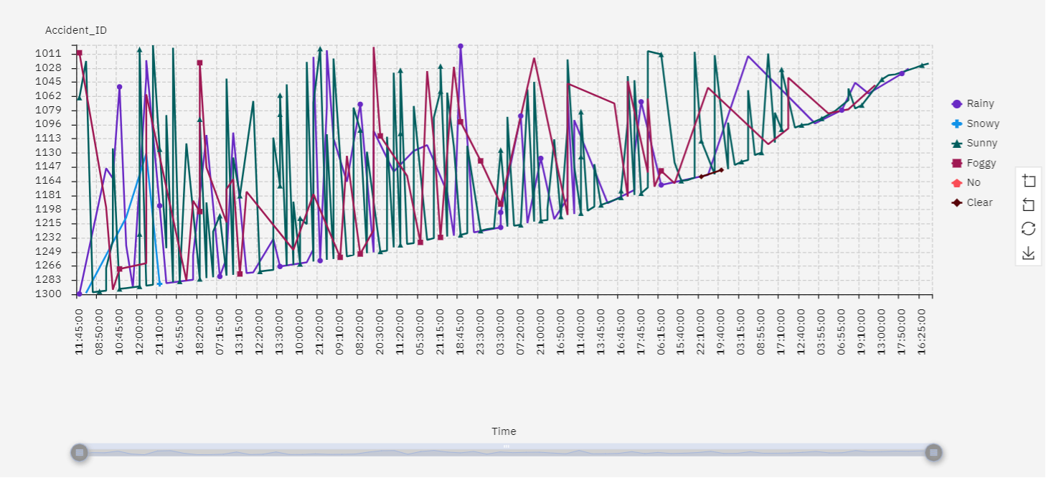
Result
Pie Chart: Distribution of Accidents by Weather Conditions:
Slices: Weather Conditions
Values: Count of Accidents
Purpose: To visualize the proportion of accidents under various weather conditions.
Bar Chart: Number of Accidents by Road Type
X-axis: Road Type
Y-axis: Count of Accidents
Purpose: To compare the number of accidents on different types of roads.
Time Series Line Chart: Number of Accidents Over Time
X-axis: Time (e.g., Date, Hour)
Y-axis: Count of Accidents
Purpose: To show the trend of accidents over time and identify peak periods.

Slide 8

Project Link
https://github.com/Chaitri02/Road-Traffic-Accident-Prediction

Slide 9
Conclusion
The developed predictive models effectively analyze historical data and real-time inputs to accurately forecast potential road accident hotspots. This enhances the ability to take proactive measures to prevent accidents and improve road safety.
The interactive dashboard integrated with IBM Watson Assistant allows user to effortlessly explore and query accident prediction data.
The system provides valuable insights and recommendations for traffic management authorities, enabling them to implement targeted safety measures, improve infrastructure, and formulate effective policies to reduce accident rates and enhance overall road safety.
By leveraging IBM Watson Studio and IBM Watson Machine Learning, the solution is scalable and can integrate real-time data sources. This ensures that the model remains up-to-date with current conditions, providing timely and relevant predictions that can adapt to changing circumstances.

Slide 10
Future scope
Enhanced Data Integration: Incorporate additional data sources such as driver behavior analytics, vehicle telemetry, and social media feeds to improve prediction accuracy and provide more comprehensive insights.
Real-Time Incident Response: Develop a real-time incident response system that alerts emergency services immediately when an accident is predicted or detected, reducing response times and potentially saving lives.
Predictive Maintenance and Policy Formulation: Utilize predictive insights to inform road maintenance schedules and develop targeted policies for high-risk areas. This can lead to more effective resource allocation and long-term improvements in road safety infrastructure.

Slide 11
References
IBM Watson Assistant tutorial

Slide 12
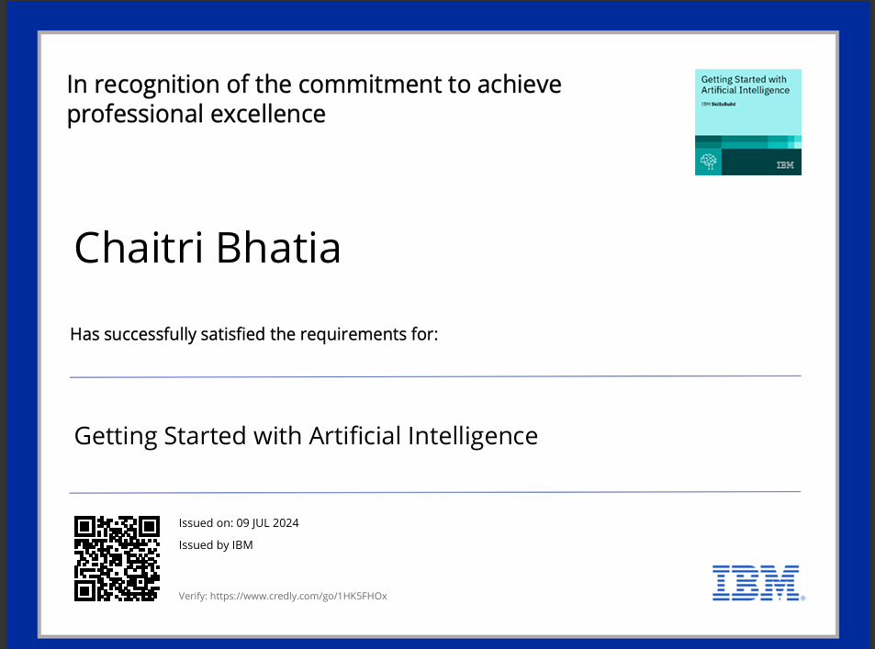
course certificate 1

Slide 13
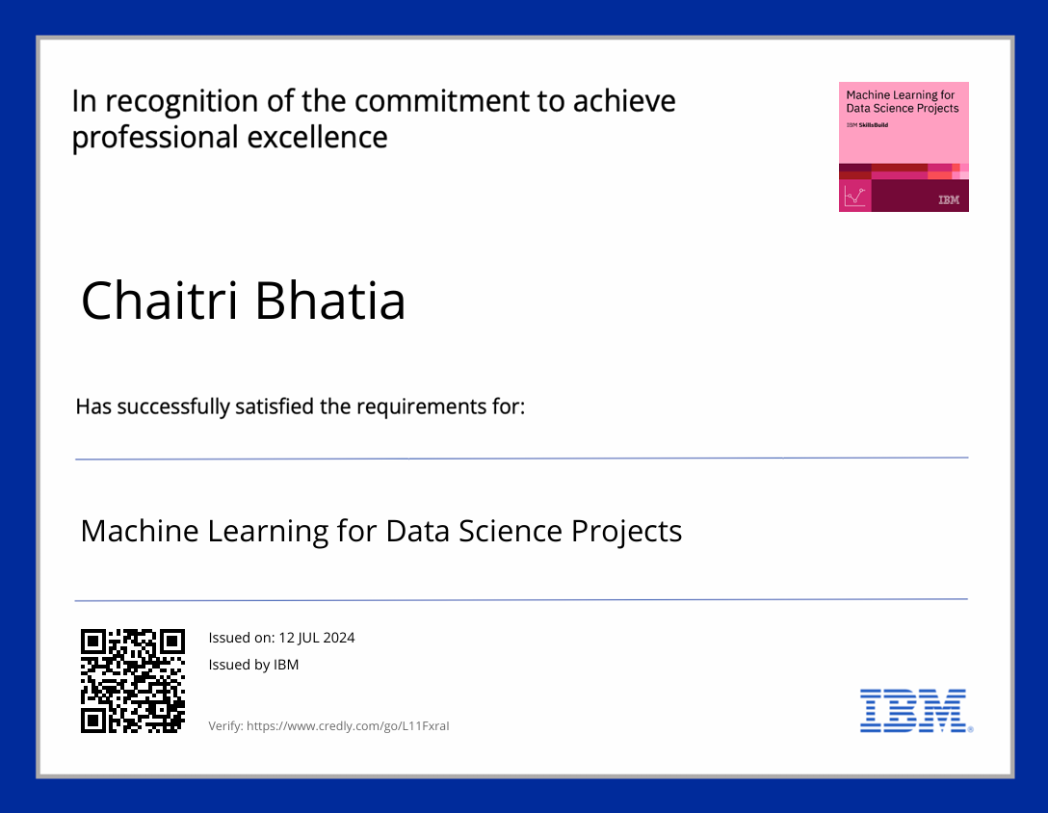
course certificate 2

Slide 14
THANK YOU

